Slide 1
WELCOME
Operating System

Slide 2
About The OS(History)
The First generation(1940’s to early 1950’s)
When electronic computers were first introduced in the 1940’s they were created without any operating systems. All programming was done in absolute machine language, often by wiring up plugboards to control the machine’s basic functions. During this generation computers were generally used to solve simple math calculations, operating systems were not necessarily needed.

Slide 3
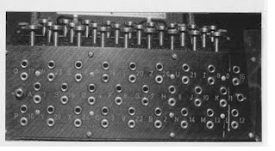
About The OS(History)
The First Generation Image

Slide 4
About The OS(History)
The Second Generation(1955-1965)
The first operating system was introduced in the early 1950s, it was introduced in the early by general motors for IBM’s machine the 701. operating systems in the 1950s were called single-stream batch processing systems because the data was submitted in groups.
These new machines were called mainframes, and they were used by professional operators in large computer rooms. Since there was such as high price tag on these machines, only government agencies or large corporations were able to afford them.

Slide 5
About The OS(History)
The Third Generation (1965-1980)
By the late 1960s operating systems designers were able to develop a system of multiprogramming in which a computer program will be able to perform multiple jobs at the same time. The introduction of multiprogramming was a major part in the development of operating systems because it allowed a CPU to be busy nearly 100 percent of the time that it was in operations.
Another major development during the phenomenal growth of minicomputers .

Slide 6
About The OS(History)
Starting with the DEC PDP-1 in 1961. The PDP -1 had only 4K of 18-bit words , but at $120.000 per machine (less than 5 percent of the price of a 7094), it sold like hotcakes .
The microcomputers help create a whole new industry and the development of more PDP’s helped lead to the creation of personal computers which are created in the fourth generation.

Slide 7
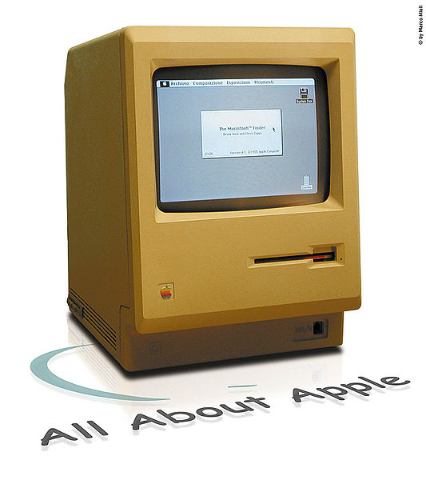
About The OS(History)
The Third Generation Image

Slide 8
About The OS(History)
The Fourth Generation (1980-Present day)
The fourth generation of operating systems saw the creation of personal computing. Although these computers were very similar to the minicomputers developed in the third generation, personal computers cost a very small fraction of what minicomputers cost. A personal computer was so affordable that it made it possible for a single individual could be able to own one for personal use while minicomputers where still at such a high price that only corporations could afford to have them.

Slide 9
About The OS(History)
One of the major factors in the windows Operating System was created in 1975 when Paul Allen and Bill Gates had a vision to take personal computing to the next level . They introduced the MS-DOS in 1981 although it was effective it created much difficulty for people who tried to understand its cryptic commands . Windows went on to become the largest operating system used in technology today with releases of Windows 95, Windows 98, Windows XP(Which is currently the most used operating system to this day), and their newest operating system Windows 7.

Slide 10
About The OS(History)
Along with Microsoft, Apple is the other major operating system created in this 1980s . Steve jobs, co founder of Apple , created the Apple Macintosh which was a huge success due to the fact that it was so user friendly . Windows development throughout the later years were influenced by the Macintosh and it created a strong competition between the two companies . Today all of our electronic devices run off of operating systems , from our computers and motor vehicles .

Slide 11
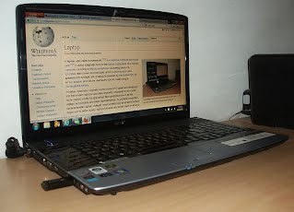
About The OS(History)
And as technology advances , So do operating systems.
The Fourth Generation image

Slide 12
Various Types OS
An Operating System Performs all the basic tasks like managing files , processes , and memory . Thus operating system acts as the manager of all the resources , resources manager . Thus , the operating system becomes an interface between user and machine.
Types of Operating Systems:
→Batch Operating System
→ Time-Sharing Operating Systems

Slide 13
Various Types OS
→ Distributed Operating System
→ Network Operating Systems
→ Real-Time Operating Systems
→ Hard Real –Time Systems
→ Soft Real – Time Systems

Slide 14
Various Types OS
Batch Operating Systems
This type of operating systems does not interact with the computer directly . There is an operator which takes similar jobs having the same requirement and group them into batches . It is the responsibility of the operator to sort jobs with similar needs.

Slide 15
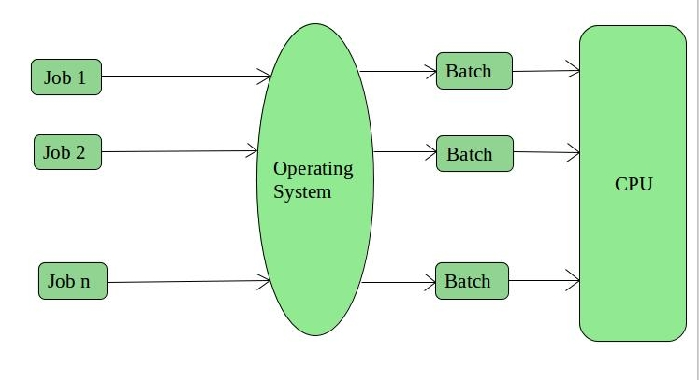
Various Types OS

Slide 16
Various Types OS
Advantages of Batch Operating System
. It is very difficult to guess or know the time required for any job to complete . Processors of the batch systems know how long the jop would be when it is in queue.
. Multiple users can share the batch systems.
. The idea time for the batch system is very less.
. It is easy to manage large work repeatedly in batch systems .

Slide 17
Various Types OS
Disadvantages of Batch Operating System:
The computer operators should be well known with batch systems.
Batch Systems are hard to debug.
It is sometimes costly.
The other jobs will have to wait for an unknown time if any job fails.
Example of Batch based Operating System:
Payroll System , Bank Statements , Etc..

Slide 18
Various Types OS
Time – Sharing operating Systems
Each task is given some time to execute so that all the tasks work smoothly. Each user gets the time of CPU as they use a single system . Them systems are also known as Multitasking Systems .
The task can be from a single user or different users also . The time each task gets to execute is called quantum . After this time interval is over OS switches over to the next task.

Slide 19
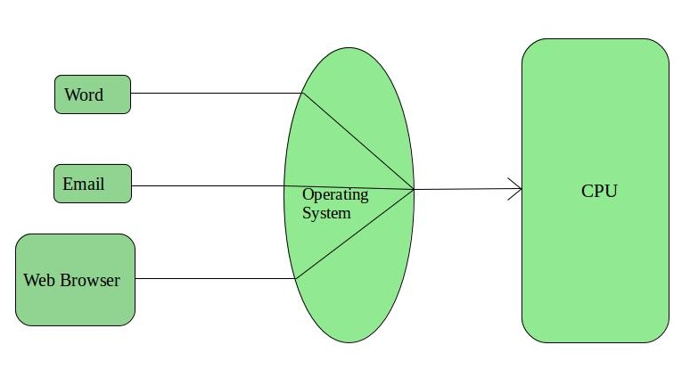
Various Types OS

Slide 20
Various Types OS
Advantage of Time-Sharing OS:
Each task gets an equal opportunity
Fewer chances of duplication of software
CPU idle time can be reduced
Disadvantages of Time-Sharing OS:
Reliability problem

Slide 21
Various Types OS
One must have to take care of the Security and integrity of user programs and data
Data communication problem
Examples of Time-Sharing OS are :
->Multics
-> Unix ,

Slide 22
Various Types OS
Distributed Operating System
These types of the operating system is a recent advancement in the world of computer technology and are being widely accepted all over the world and , that too , with a great pace.
Various autonomous interconnected computers communicate with each other using a shared communication network. Independent systems possess their own memory unit and CPU . These are referred to as loosely coupled systems or distributed Systems.

Slide 23
Various Types OS
This system’s processors differ in size and function.
The major benefit of working with these types of the operating system is that it is always possible that one user can access the files or software .
which are not actually present on this system but some other system connected within this network , remote access is enabled within the devices connected in that network .

Slide 24
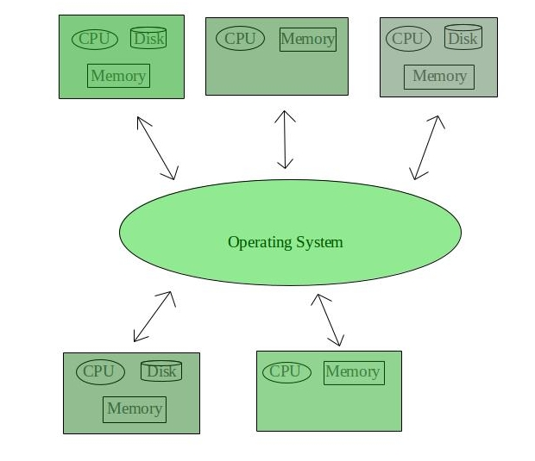
Various Types OS

Slide 25
Various Types OS
Advantage of Distributed Operating System
Failure of one Will not affect the other network communication, as all systems are independent from each other .
Electronic mail increases the data exchange speed
Since resources are being shared , computation is highly fast and durable
Load on host computer reduces
These systems are easily scalable as many systems can be easily added to the network

Slide 26
Various Types OS
Disadvantages of Distributed Operating System
Failure of the main network will stop the entire communication
To establish distributed systems the language which is used are not well defined yet . These types of systems are not readily available as they are expensive.
Not only that the underlying software is highly complex and not understood well yet.
Examples of Distributed Operating Systems – LOCUS.

Slide 27
Various Types OS
Network Operating System
These systems run on a server and provide the capability to manage data , users , groups , security , applications , and other networking functions. These types of operating systems allow shared access of files , printers , security , applications, and other networking functions over a small private network.
One more important aspect of network operating Systems is that all the users are well aware of the underlying configuration , of all other users within the network , their individual connections ,. And that’s why these computers are popularly known as tightly coupled systems.

Slide 28
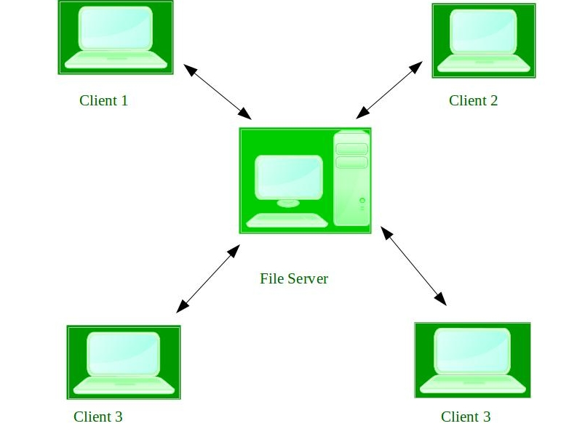
Various Types OS

Slide 29
Comparison between OS
In todays world , we see a strong showing for all three operating systems, Microsoft Windows , Linux and macOS. Competition spurs creativity and combats complacency , and there is of new development for these three operating systems.
If you want to know more about the similarities and differences in these three operating systems , keep reading.

Slide 30
Comparison between OS
This article is for those who want to learn :
The common versions of each operating system
Some of the basic difference
How the operating system terminology
How to choose one operating system over another

Slide 31
Comparison between OS
After all , an operating system (OS) is the fundamental base of the computer for running the software and apps we all rely on daily.
Because this is a critical part of foundational IT knowledge , CompTIA A+(Exam 220-1002) covers all three operating systems . CompTIA cert Master Labs for Linux+, Security+, Server+, Network+, and Cloud+ also contain many Linux and windows –based hands –on activites .

Slide 32
Comparison between OS
Common OS Versions | Client | Server | Regular User | Power User | Administrator
Windows 10 | X |  | X
Windows Server |  | X |  |  | X
Red Hat Enterprise Linux |  | X |  |  | X
Ubuntu Desktop (Linux) | X |  | X | X
Kali Linux | X |  |  | X | X
macOS Big Sur | X |  | X | X

Slide 33
The Architecture of Windows OS & Linux OS
Linux : Linux could be a free and open supply OS supported operating system Standards . It is provides programming interface still as program me compatible with operating system primarily based systems and provides giant selection applications .
A UNIX operating system additionally contains several severally developed parts, leading to UNIX operating system additionally contains several severally developed parts, leading to UNIX operating system that is totally compatible and free from proprietary code.

Slide 34
The Architecture of Windows OS & Linux OS
Windows : Windows may be a commissioned OS Within which ASC11 Text file is inaccessible . Its designed for the people with the angle of getting no programming information and for business and alternative industrial users . It’s terribly straightforward and simple to use.
The distinction between Linux and windows package is that Linux is completely freed from price whereas windows is marketable package and is expensive .

Slide 35
The Architecture of Windows OS & Linux OS
Associate operating system could be a program meant to regulate the pc or computer hardware Associate behave as an treater between user and hardware .
Linux is a open supply package wherever users will access the ASC11 text file and might improve the code victimization the system on the opposite hand , in windows , users can’t access ASC11 text file , and it’s a authorized OS let’s see the difference between Linux and Windows.

Slide 36
The Architecture of Windows OS & Linux OS
S.no | Linux | Windows
001 | Linux is a open source operating system. | While Windows are the not the open source operating system
002 | Linux is free of cost | While it is costly
003 | It’s file name case- sensitive | While it’s file name is case – insensitive
004 | In Linux ,monolithic kernel is used | While int his , micro kernel is used
005 | Linux is more efficient in comparison of Windows | While windows are less efficient
006 | There is forward slash is used for Separating the directories | While there is back slash is used for separating the directories
007 | Linux provides more security than windows | While it provides less security than Linux

Slide 37
The Architecture of Windows OS & Linux OS
S.no | Linux | Windows
008 | Linux is widely used in hacking purpose based systems. | While windows does not provide much efficiency in hacking
009 | There are 3 types of user account (1) Regular (2) Root (3) Service account | There are 4 types of user account (1) Administrator (2)standard (3) Child (4) Guest
010 | Root user is the super user and has all administrative privileges | Administrator user has all administrative privileges of computers
011 | Linux file naming convention in case sensitive. Thus , Sample and SAMPLE are 2 different files in Linux\Unix operating systems. | In windows , you cannot have 2 files with the same name in the same folder.

Slide 38
Mobile OS and Its Comparison
Mobile and Desktop OS are developed differently and for different purposes. Desktop operating systems are older and have a great spread and penetration among a broader population.
Microsoft Windows and Mac OS have emerged as the two most popular OS, including Linux, free BSD, open BSD, and GNU, have also gained popularity.
Desktop operating systems are not designed to operate mobile devices via wireless networks.

Slide 39
Mobile OS and Its Comparison
In this article, you will learn the difference between the Mobile OS and Desktop OS . Bur before discussing the difference, you must known about the Mobile Operating System and Desktop Operating System.
A mobile OS allows applications software to operate on mobile devices. It is similar to desktop OS in certain ways, but it is simpler and lighter in comparison.
Smartphone operating systems include Windows Mobile, palm webOS, Symbian OS, Android, and Memo are all variations on the Linux OS.

Slide 40
Mobile OS and Its Comparison
The iPhone OS is based on BSD and Ne XTSTEP, both of which are UNIX-related.
Mobile Operating Systems combine computer and handheld device features. They frequently incorporate a cellular modem and SIM card tray for phone and internet services.
When you acquire a mobile device, it comes preinstalled with device-specific operating systems.

Slide 41
Mobile OS and Its Comparison
Features of The Operating System
It is very easy to understand and utilize. The graphics of the mobile operating system is very attractive, and its features are very powerful and easy to use.
An OS gives focus on controlling the data and network usages. It also keeps the limit and requirements in focus.
It provides better apps to use. The apps should be simple and attractive.

Slide 42
Mobile OS and Its Comparison
The desktop OS is the environment in which a user manages a personal computer. It helps in the management of system hardware and software resources.
For example , Windows, Mac OS, and various Linus distributions. It supports basic features, including task scheduling, printing, I/O, peripheral control, and memory allocation.
On the desktop, the OS user needs an operating system. The OS acts as a bridge between programs and system hardware.

Slide 43
Mobile OS and Its Comparison
Some OS require installation, while others may come pre-installed with new computers.
Microsoft Windows, Mac OS, and Linux are the most popular desktop OS. Graphical user Interface (GUI) is a feature of modern operating systems (GUI).
Microsoft Windows OS was introduced in the mid-1980s. There are various versions of Windows, the most recent of which are windows 11 (2021), Windows 10 (2015), Windows 8 (2012), Windows 7 (2009), and Windows Vista (2007).

Slide 44
Mobile OS and Its Comparison
Windows comes pre-installed on most of the new PCs, making it the most common OS in the world.
Apple’s Mac OS is another well-known operating system. It is preinstalled on all Macintosh computers.
Mo java (2018), High Sierra (2017), and Sierra (2016) are some of the major versions.

Slide 45
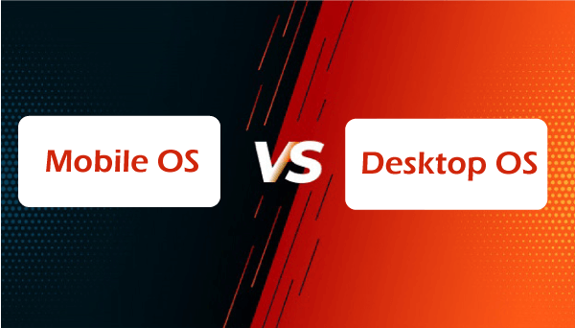
Mobile OS and Its Comparison
Main Differences between the Mobile and Desktop Operating System :

Slide 46
Mobile OS and Its Comparison
A mobile OS is a type of OS that allows application software to operate on mobile devices. On the other hand, the desktop OS is the environment in which a user handles a personal computer.
The mobile operating system uses a flash drive to store the data. On the other hand, the desktop operating system uses hard drives and flash drives to store data.
Mobile OS needs minimum RAM to optimize. On the other hand, the desktop OS needs huge memory to operate.

Slide 47
Mobile OS and Its Comparison
Mobile OS handles cellular and wireless connectivity and device access. On the other hand, the desktop OS handles the software and hardware resources of the system.
Mobile OS runs on touchscreen or touchpad devices. On the other hand, the desktop OS runs through many input devices, including mouse, keyboard.
Mobile OS takes less time to boot. On the other hand, the desktop OS boots much slower.

Slide 48
Mobile OS and Its Comparison
Mobile OS is optimized to work under fewer power requirements and has a feature to avoid energy loss. On the other hand, the desktop OS is not readily optimized for energy loss.
Some examples of the mobile OS are Apple iOS, Blackberry OS, iPhone, Google Android, Bada, Symbian OS, palm OS, Windows Mobile OS, Harmony OS, WebOS. In contrast, some examples of the desktop OS are Windows 10, Windows Vista.

Slide 49
Mobile OS and Its Comparison
Features | Mobile Operating System | Desktop Operating System
Definition | It is a type of operating system that allows application software to operate on mobile devices. | It is the environment in which a user handles a personal computer.
Memory Requirement | It needs minimum RAM to optimize | It needs huge memory to operate
Storage | It uses a flash drive to store the data | It uses hard drives and flash drives to store data
Boot time | It takes less time to boot | It takes much time to boot

Slide 50
Mobile OS and Its Comparison
Features | Mobile Operating System | Desktop Operating System
Purpose | It handles cellular and wireless connectivity and device access | It handles the software and hardware resources of the system
Power | It is optimized to work under minimal power needs and has a feature to prevent energy loss | It is readily optimized for energy loss
Interface | It runs on touchscreen or touchpad device | It runs through many input device, including mouse, keyboard.
Example | Some examples of the mobile OS are Apple iOS, Google Android, Bada, Palm OS, Symbian OS, Windows Mobile OS, WebOS. | Some examples of the desktop OS are Windows 10, MacOS, Windows Vista.

Slide 51


